Slide 1
Introduction to Computer Networks
Lecturer: Ngo Huy Bien
Software Engineering Department
Faculty of Information Technology
VNUHCM - University of Science
Ho Chi Minh City, Vietnam
nhbien@fit.hcmus.edu.vn

Slide 2

Objectives

Slide 3

Contents
Computer Networks
Network Software
Network Protocols
The OSI Reference Model
The TCP/IP Reference Model
The TCP/IP 5-Layer Model

Slide 4

References
Andrew S. Tanenbaum and David J. Wetherall (2014). Computer Networks. Pearson Education.
Reinhard Voglmaier (2004). The ABCs of LDAP: How to Install, Run, and Administer LDAP Services.

Slide 5
Basic Needs
Bandwidth and IP monitoring: firewalls support this
Hypervisors and servers status monitoring: the built-in heath monitoring features of VMWare and Server 2012 and Pingdom.com
SQL and application instances monitoring: built-in heath monitoring features of SQL and applications and Pingdom.com
OS and SQL updates: the updates should be downloaded automatically and manually reviewed and released (once a month)
Security monitoring: this should be reviewed manually together with using some scanning tools (every 6 months)
Performance monitoring: load time, load size

Slide 6
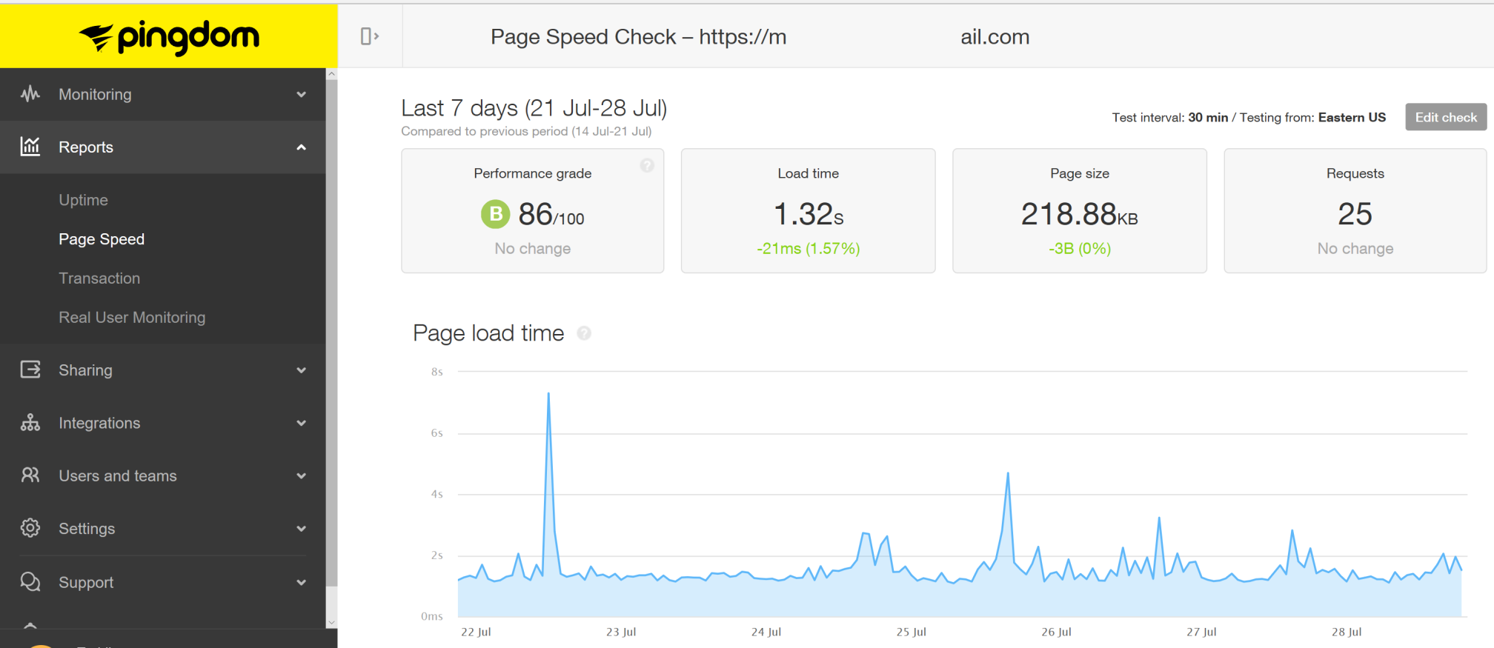
Speed Check

Slide 7
Network Monitoring Tools
https://www.paessler.com/
These tools cannot understand (and collect data from) servers/OS/SQL/applications better than the servers/OS/SQL/applications themselves.
These tools consume much resources and increase bandwidth.
These tools are installed inside our network. It means that our network issues can affect them. A remote tools (like Pingdom.com) do not suffer this.
The tools can create security breaches themselves.
IMO a network monitoring tool is only useful if we have a very large number of servers and very complicated network and applications and we need centralized visualized and detailed reports.
I believe that built-in features and email and SMS notifications are enough for small number of servers.

Slide 8


Slide 9
Computer Networks [1]
Computer network: A large number of separate but interconnected computers.

Slide 10
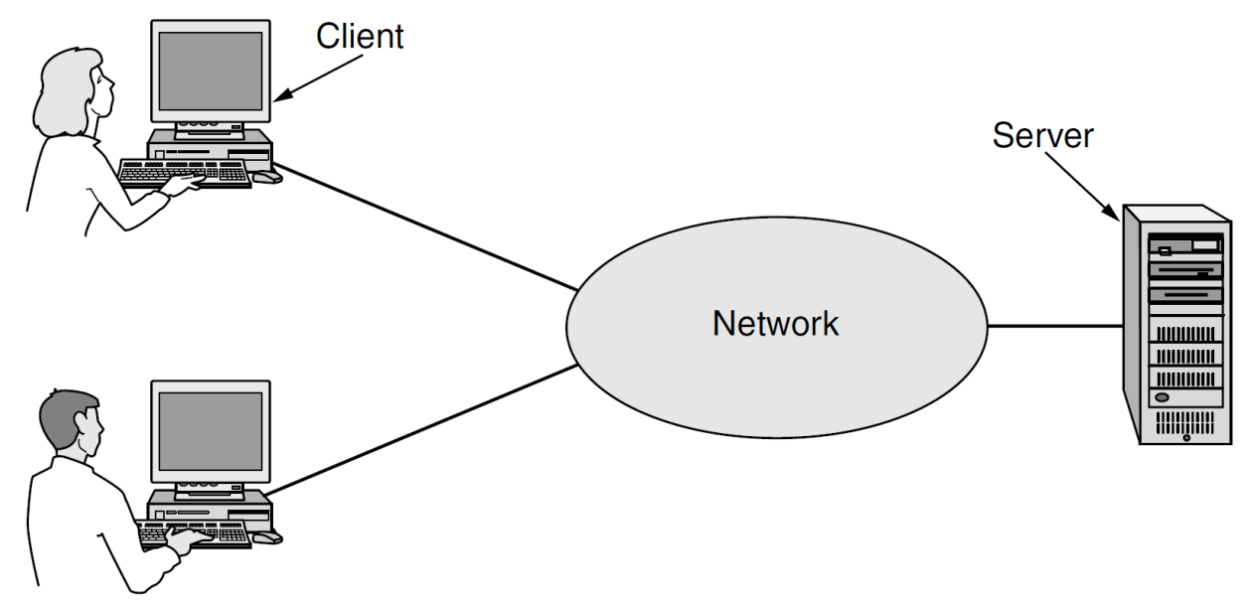
Why Computer Networks?
Resource sharing
The data are stored on powerful computers called servers.
The employees have simpler machines, called clients, on their desks, with which they access remote data.
This whole arrangement is called the client-server model.

Slide 11
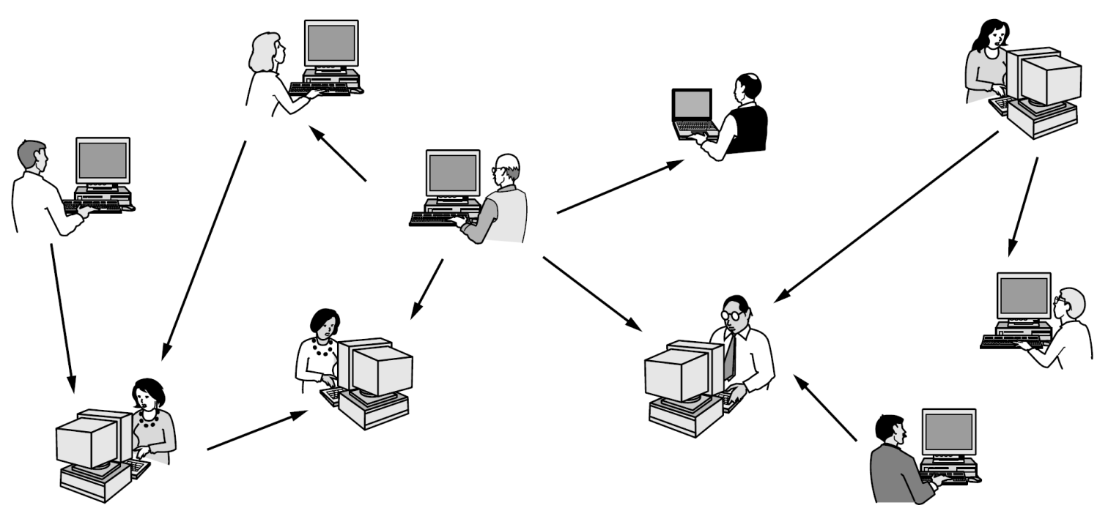
Peer-to-Peer System
In a peer-to-peer system there are no fixed clients and servers.
Example: BitTorrent

Slide 12
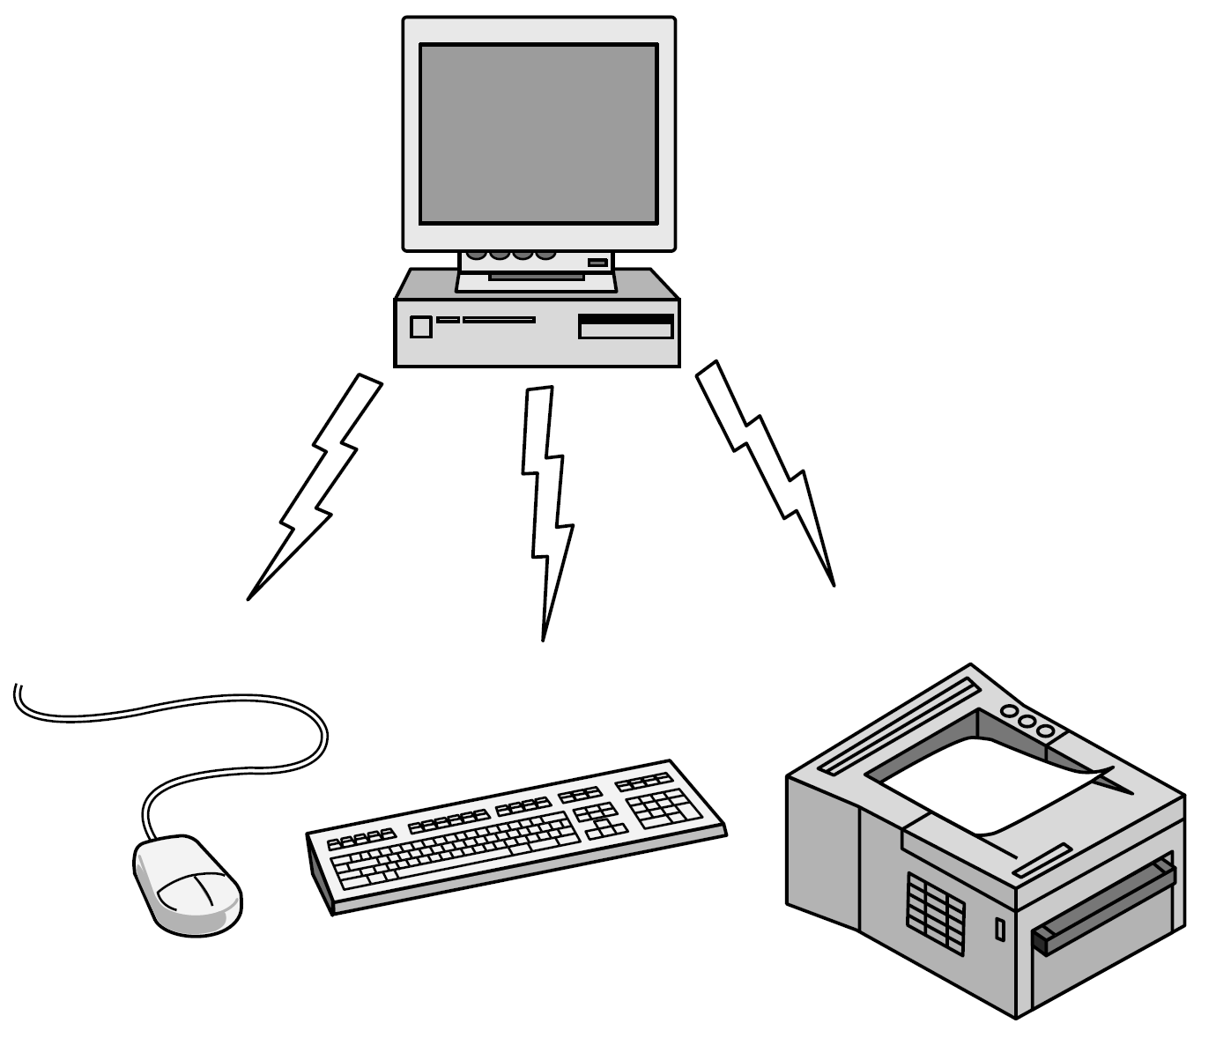
Personal Area Networks
PANs (Personal Area Networks) let devices communicate over the range of a person.
A common example is a wireless network that connects a computer with its peripherals.
Example: Bluetooth

Slide 13
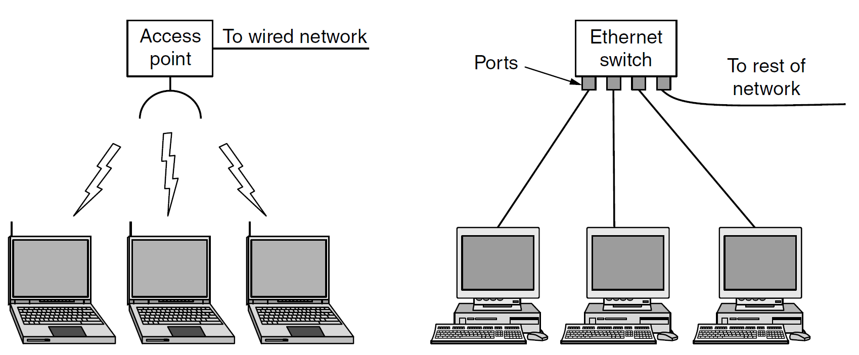
Local Area Networks
A LAN is a privately owned network that operates within and nearby a single building like a home, office or factory.
LANs are widely used to connect personal computers and consumer electronics to let them share resources (e.g., printers) and exchange information.
When LANs are used by companies, they are called enterprise networks.

Slide 14
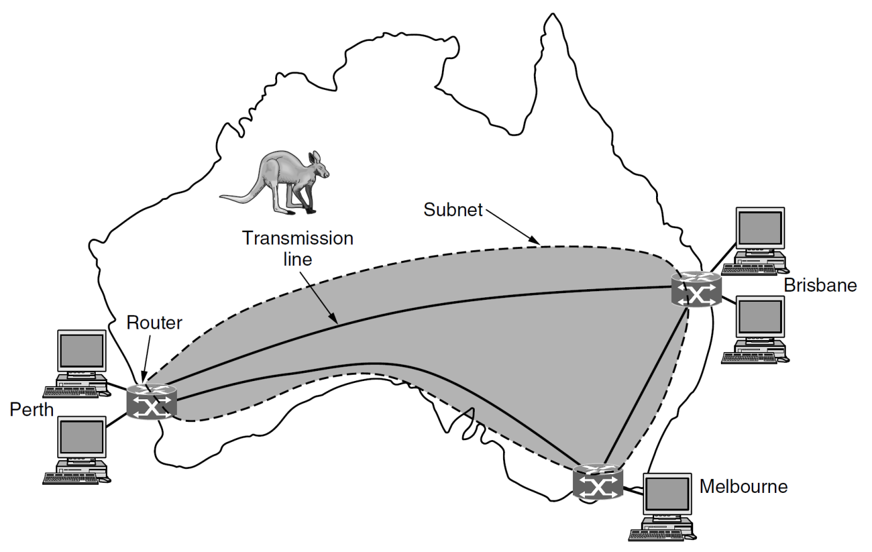
Wide Area Networks
A WAN (Wide Area Network) spans a large geographical area, often a country or continent.
Example: A network that connects offices in Perth, Melbourne, and Brisbane.

Slide 15
WAN Terminologies
We will follow traditional usage and call these machines hosts.
The rest of the network that connects these hosts is then called the communication subnet, or just subnet for short.
In most WANs, the subnet consists of two distinct components: transmission lines and switching elements.
Transmission lines move bits between machines.
Switching elements, or just switches, are specialized computers that connect two or more transmission lines.
These switching computers have been called by various names in the past; the name router is now most commonly used.

Slide 16
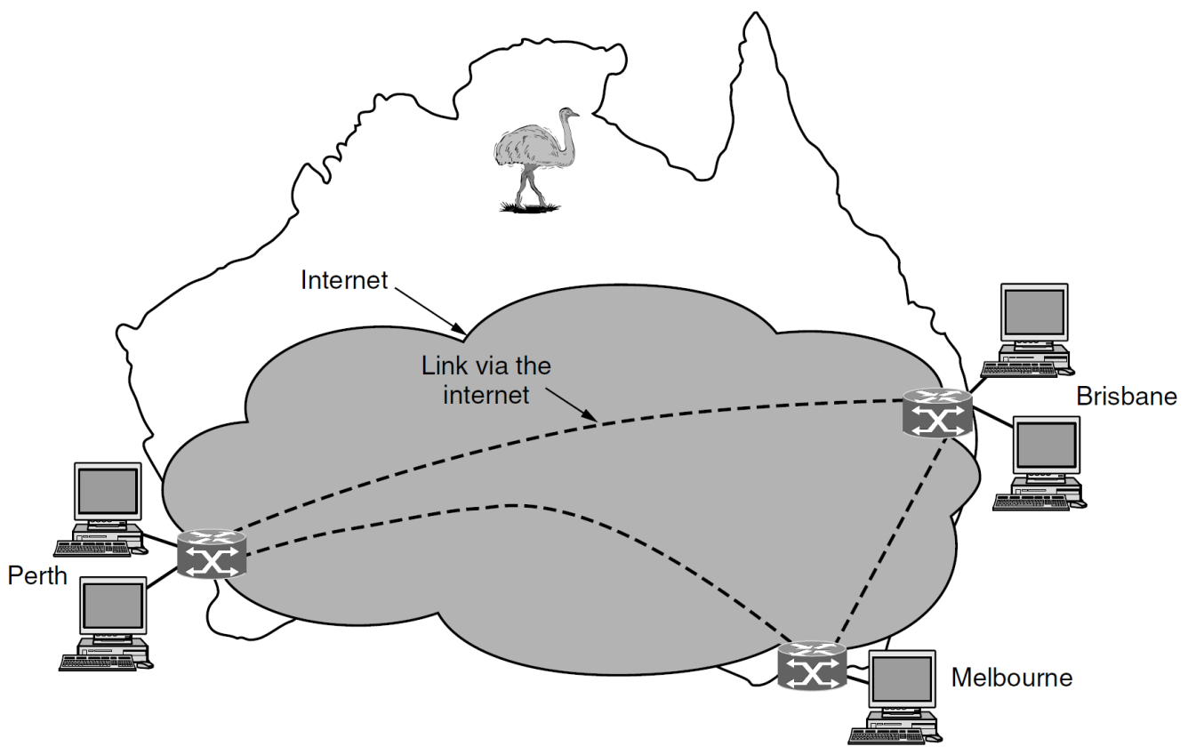
Virtual Private Networks
Rather than lease dedicated transmission lines, a company might connect its offices to the Internet.
This allows connections to be made between the offices as virtual links that use the underlying capacity of the Internet.

Slide 17
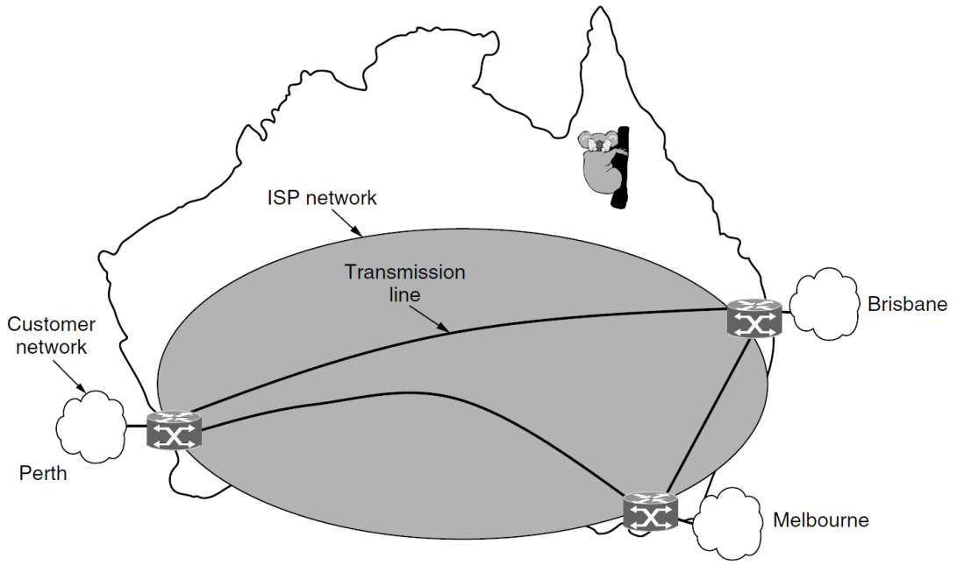
ISP Networks
The subnet may be run by a different company.
The subnet operator is known as a network service provider and the offices are its customers.
The subnet operator will connect to other customers too, as long as they can pay and it can provide service.
Such a subnet operator is called an ISP (Internet Service Provider) and the subnet is an ISP network. Its customers who connect to the ISP receive Internet service.

Slide 18
The Internet
The Internet being the most well-known example of a network of networks.

Slide 20
Network Software

Slide 21
Distributed Systems
A distributed system: a collection of independent computers appears to its users as a single coherent system.

Slide 22
World Wide Web
A well-known example of a distributed system is the World Wide Web. It runs on top of the Internet and presents a model in which everything looks like a document (Web page).

Slide 23
Service Primitives
A service is formally specified by a set of primitives (operations) available to user processes to access the service.
Primitive | Meaning
LISTEN | Block waiting for an incoming connection
CONNECT | Establish a connection with a waiting peer
ACCEPT | Accept an incoming connection from a peer
RECEIVE | Block waiting for an incoming message
SEND | Send a message to the peer
DISCONNECT | Terminate a connection

Slide 24
Network Protocols [2]
Protocols are formal rules dictating the format of messages so that they can be understood by the sending and receiving partners (the computers).
Protocols are only rules. Protocols are not software or a piece of software; they simply specify how the software should behave.
Network protocol allows different computers from different suppliers using different operating systems to be connected so that they can "speak" with each other.
Protocol allows software developers to use any number of application programming interfaces (APIs) and still be able to communicate with each other without caring about the underlying hardware or operating system.

Slide 25
Network Architecture [1]
A set of layers and protocols is called a network architecture.
A list of the protocols used by a certain system, one protocol per layer, is called a protocol stack.
Between each pair of adjacent layers is an interface.
The interface defines which primitive operations and services the lower layer makes available to the upper one.

Slide 27
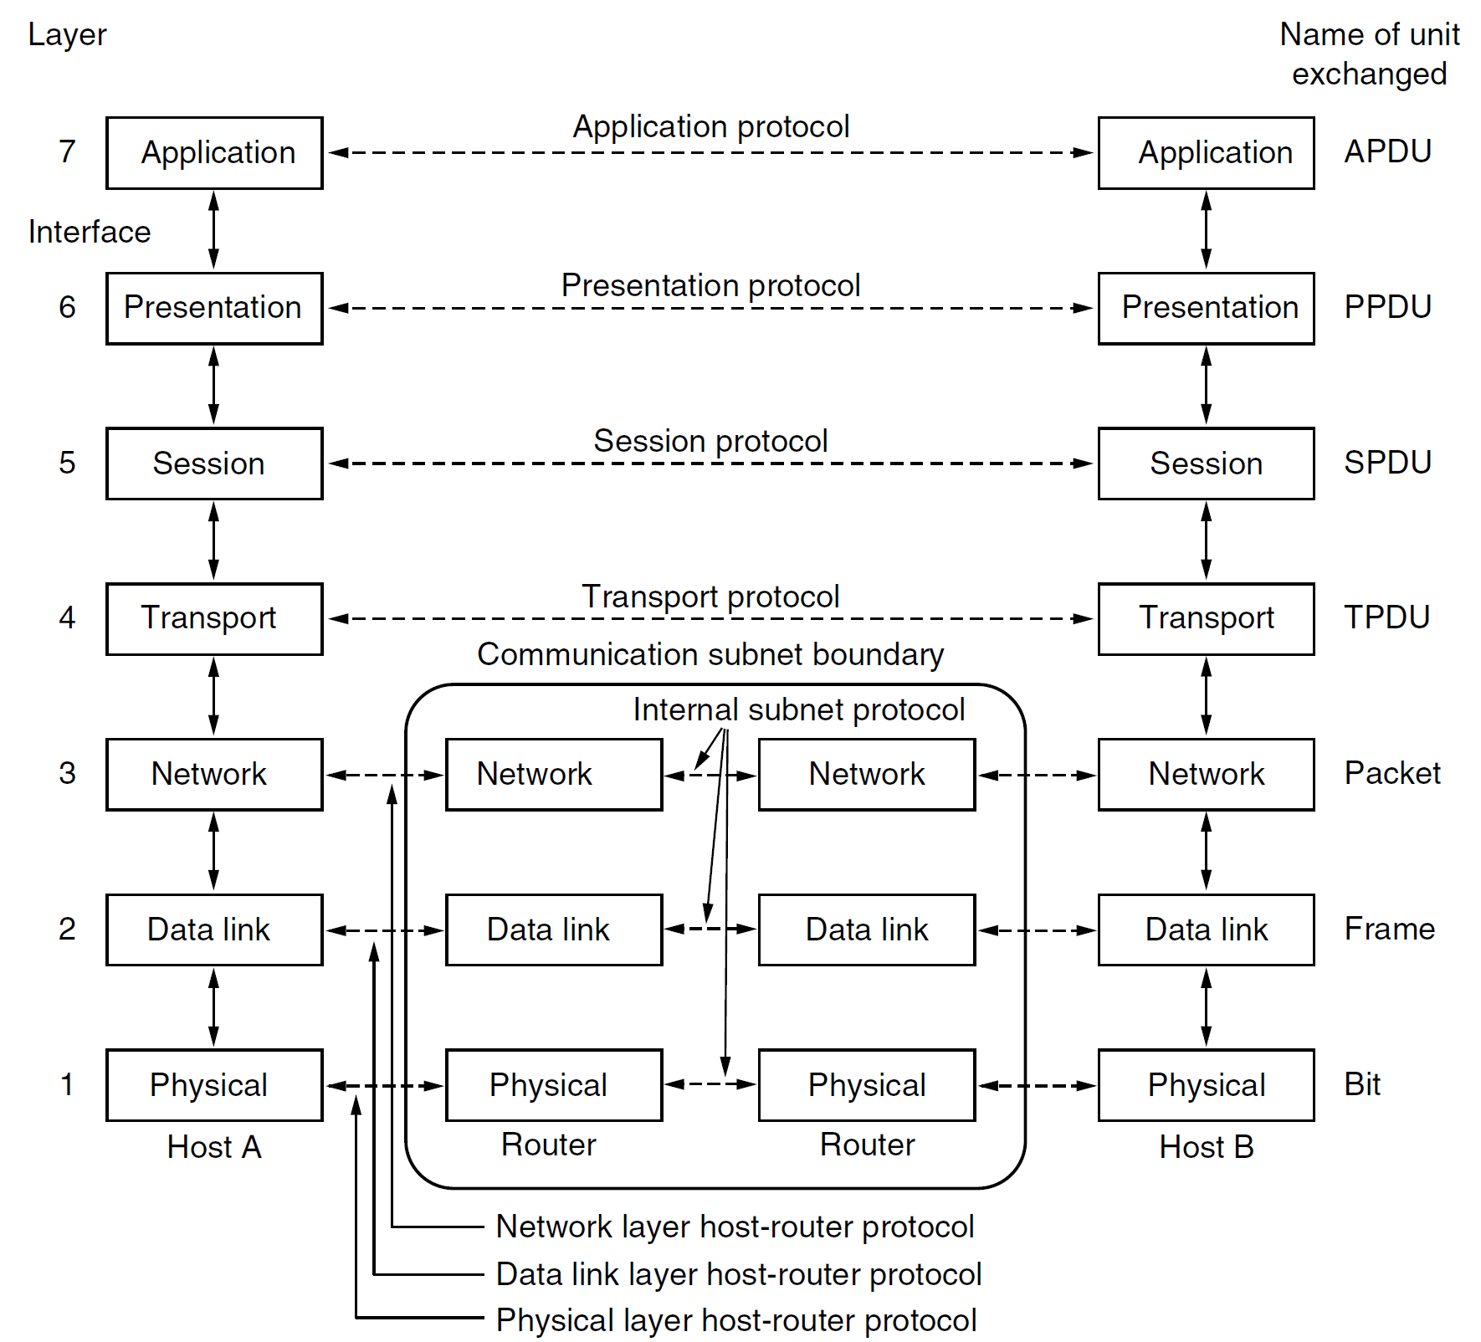
The OSI Reference Model
OSI (Open Systems Interconnection)

Slide 28
The Physical Layer
The physical layer is concerned with transmitting raw bits over a communication channel.
The design issues have to do with making sure that when one side sends a 1 bit it is received by the other side as a 1 bit, not as a 0 bit.
Typical questions here are
what electrical signals should be used to represent a 1 and a 0,
how many nanoseconds a bit lasts,
whether transmission may proceed simultaneously in both directions,
how the initial connection is established,
how it is torn down when both sides are finished,
how many pins the network connector has, and
what each pin is used for.
These design issues largely deal with mechanical, electrical, and timing interfaces, as well as the physical transmission medium, which lies below the physical layer.

Slide 29
The Data Link Layer
The main task of the data link layer is to transform a raw transmission facility into a line that appears free of undetected transmission errors.
It does so by masking the real errors so the network layer does not see them.
It accomplishes this task by having the sender break up the input data into data frames (typically a few hundred or a few thousand bytes) and transmit the frames sequentially.
If the service is reliable, the receiver confirms correct receipt of each frame by sending back an acknowledgement frame.
Another issue that arises in the data link layer (and most of the higher layers as well) is how to keep a fast transmitter from drowning a slow receiver in data.

Slide 30
The Network Layer (I)
The network layer is concerned with getting packets from the source all the way to the destination.
Getting to the destination may require making many hops at intermediate routers along the way.
To achieve its goals, the network layer must know about the topology of the network (i.e., the set of all routers and links) and choose appropriate paths through it, even for large networks.

Slide 31
The Network Layer (II)
The network layer controls the operation of the subnet.
A key design issue is determining how packets are routed from source to destination.
If too many packets are present in the subnet at the same time, they will get in one another’s way, forming bottlenecks.
When a packet has to travel from one network to another to get to its destination, many problems can arise.
The addressing used by the second network may be different from that used by the first one. The second one may not accept the packet at all because it is too large.
The protocols may differ, and so on.

Slide 32
The Transport Layer (I)
The basic function of the transport layer is to accept data from above it, split it up into smaller units if need be, pass these to the network layer, and ensure that the pieces all arrive correctly at the other end.
The transport layer also determines what type of service to provide to the session layer, and, ultimately, to the users of the network.

Slide 33
The Transport Layer (II)
It is designed to allow peer entities on the source and destination hosts to carry on a conversation.
The first one, TCP (Transmission Control Protocol), is a reliable connection-oriented protocol that allows a byte stream originating on one machine to be delivered without error on any other machine in the internet.
The second protocol in this layer, UDP (User Datagram Protocol), is an unreliable, connectionless protocol for applications that do not want TCP’s sequencing or flow control and wish to provide their own.

Slide 34
The Session Layer
The session layer allows users on different machines to establish sessions between them.
Sessions offer various services, including dialog control (keeping track of whose turn it is to transmit), token management (preventing two parties from attempting the same critical operation simultaneously), and synchronization (checkpointing long transmissions to allow them to pick up from where they left off in the event of a crash and subsequent recovery).

Slide 35
The Presentation Layer
The presentation layer is concerned with the syntax and semantics of the information transmitted.
In order to make it possible for computers with different internal data representations to communicate, the data structures to be exchanged can be defined in an abstract way, along with a standard encoding to be used "on the wire."
The presentation layer manages these abstract data structures and allows higher-level data structures (e.g., banking records) to be defined and exchanged.

Slide 36
The Application Layer
The application layer contains a variety of protocols that are commonly needed by users.
The early ones included virtual terminal (TELNET), file transfer (FTP), and electronic mail (SMTP).
One widely used application protocol is HTTP (HyperText Transfer Protocol), which is the basis for the World Wide Web.

Slide 37
Summary
Data link layer: This layer is responsible for putting the data into datagrams and error checking.
Network layer: Sometimes called "communication layer," this layer is responsible for the packet delivery. It isolates the upper levels from network details, such as routing, and provides just at this level reliable transfer of information.
Session layer: This layer is responsible for the management of sessions, i.e., the setup, the maintenance, and the correct closing of sessions. This can be, for example, remote terminal access.
Presentation layer: This layer handles such issues as data decryption and encryption, text or graphics compression, conversion, and formatting.
Application Layer
Presentation Layer
Session Layer
Transport Layer
Network Layer
Data Link Layer
Physical Layer

Slide 39
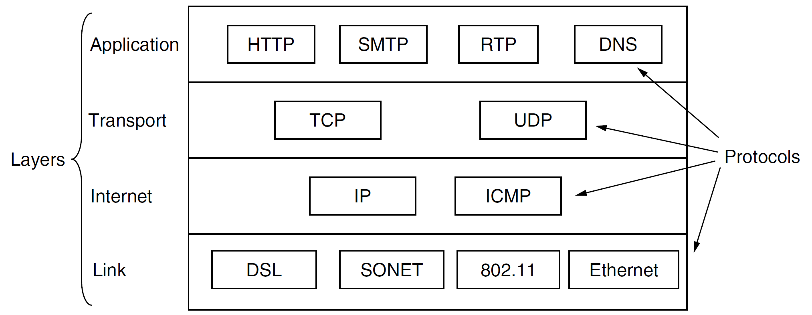
The TCP/IP Reference Model
The network be able to survive loss of subnet hardware, without existing conversations being broken off.
The DoD wanted connections to remain intact as long as the source and destination machines were functioning, even if some of the machines or transmission lines in between were suddenly put out of operation.

Slide 40
Network Interface Layer [2]
Network interface layer: This lowest layer is responsible for accessing the underlying hardware.
The network interface layer is constantly revised as new hardware is developed.
TCP/IP does not prescribe any specific interface for the actual hardware. You can find Ethernet, token-ring, X.25, ATM, or other systems.
This layer also maps IP addresses into physical addresses and transforms the data into frames before transmission.
Application Layer
Transport Layer
Internet Layer
Network Interface Layer

Slide 41
The Internet Layer [1]
The internet layer is the linchpin that holds the whole architecture together.
Its job is to permit hosts to inject packets into any network and have them travel independently to the destination (potentially on a different network).
They may even arrive in a completely different order than they were sent, in which case it is the job of higher layers to rearrange them, if in-order delivery is desired.
Note that ‘‘internet’’ is used here in a generic sense, even though this layer is present in the Internet.
The internet layer defines an official packet format and protocol called IP (Internet Protocol), plus a companion protocol called ICMP (Internet Control Message Protocol) that helps it function.

Slide 42
The Internet Layer [2]
Internet layer: This next higher level is the heart of the TCP/IP protocol.
The IP (Internet Protocol), described in RFC 791, is the most important protocol of this layer.
IP facilitates fast delivery of packets by ignoring the details of datagram delivery. It does not care whether the datagrams arrive in the correct order, whether they arrive more than once, or whether they arrive at all.
The IP level can afford to be unreliable because it depends on other levels to align the packets in the correct order.
Application Layer
Transport Layer
Internet Layer
Network Interface Layer

Slide 43
The Transport Layer
Transport layer: This is the layer just above the internet layer, which facilitates the datagram delivery from one computer to another.
The transport layer delivers the data to the correct application, providing end-to-end communication between applications. There are two substantially different protocols that can do this:
User Datagram Protocol (UDP), an unreliable, connectionless protocol
Transmission Control Protocol (TCP), which provides a reliable stream of delivery. TCP guarantees that the packets are delivered in the correct order and ensures the retransmission of any packets that do not arrive from the underlying IP layer. This guarantee comes at the cost of a certain overhead. For short messages sent across the network, this overhead is too high, and UDP is used instead. UDP avoids these time-consuming controls. If necessary, the application layer can provide these controls.
Application Layer
Transport Layer
Internet Layer
Network Interface Layer

Slide 44
The Application Layer
Application layer: The application layer can be one or several of a series of well-known protocols, including:
FTP: the File Transfer Protocol that facilitates file transfer from one computer to another
SMTP: the Simple Mail Transfer Protocol that makes e-mail possible
Telnet: a remote terminal protocol
HTTP: the Hypertext Transfer Protocol used by Web servers and browsers
LDAP: the Lightweight Directory Access Protocol.
Application Layer
Transport Layer
Internet Layer
Network Interface Layer

Slide 45
The TCP/IP Reference Model History
The Defense Advanced Research Projects Agency, the research branch of the U.S. Department of Defense, created the TCP/IP model in the 1970s for use in ARPANET, a wide area network that preceded the internet. TCP/IP was originally designed for the Unix OS, and it has been built into all of the OSes that came after it.
The TCP/IP model and its related protocols are now maintained by the Internet Engineering Task Force.

Slide 47
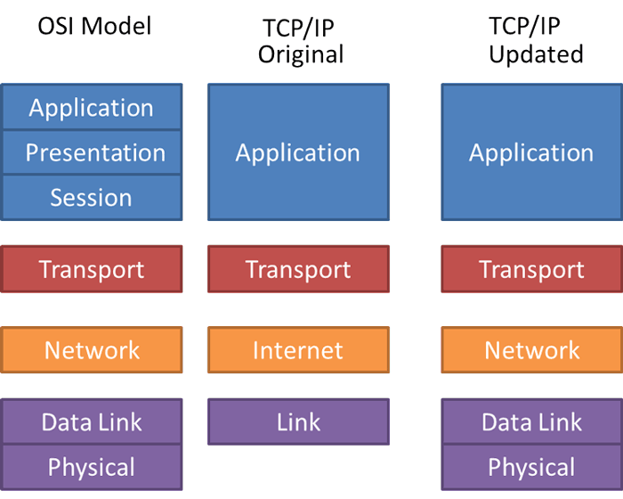
The TCP/IP 5-Layer Model
An update of the original TCP/IP reference model.

Slide 48
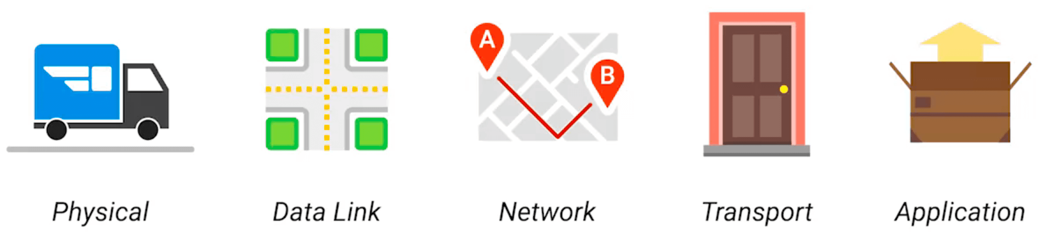
Analogy

Slide 50
Internet Standards: RFCs
The Internet Engineering Task Force (IETF) maintains the complete list of Internet standards on its Web site at http://www.ietf.org
A mechanism known as "requests for comment" (RFC) is used to facilitate collaboration and sharing of open standards.
When a researcher implements a new protocol, she proposes it as a standard to the IETF. This proposal is published first as a draft on the RFC list.
Every RFC has a status describing its validity. The proposal of an RFC author has the status "draft," and the final status is "standard."

Slide 51

Thank You & See You Again

